Slide 1
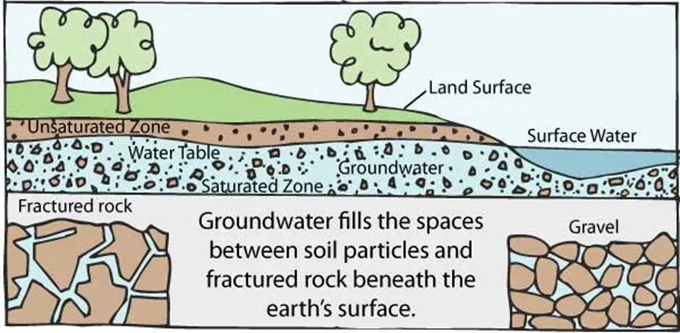
Smart Ground Water Recharge with Net Metering
Team Name: Neo Smart
Team Members: Apoorva Mathad
Keerti Ramesh
Rekha K
Arpana G
Asif K
Aijaz Kittur

Slide 2
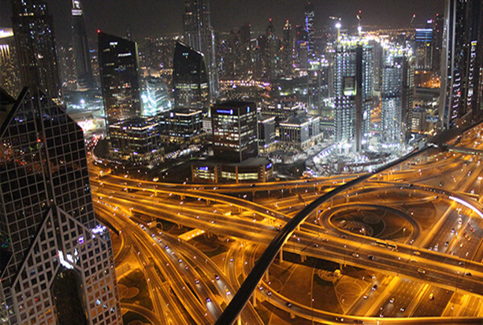
Smart City
A smart city is an urban development using Information and Communication Technology (ICT) and Internet of Things (IoT) to provide useful information to effectively manage resources and assets. This includes data collected from citizens and mechanical devices, that are processed and analyzed to monitor and manage traffic and transport systems, power plants, water supply networks, waste disposal, etc.

Slide 3
How do Smart cities work?
A smart city is an intelligent city that integrates digital technologies into its networks, services and infrastructure. It means smart urban transportation networks, upgraded water supply and waste disposal facilities and more efficient ways to light and heat buildings.
What is the future of smart cities?
Smart cities offer better use of space, less traffic, cleaner air, and more efficient civic services, all of which increases quality of life. What's more, smart cities provide more career and economic opportunities as well as stronger links with the community.

Slide 4
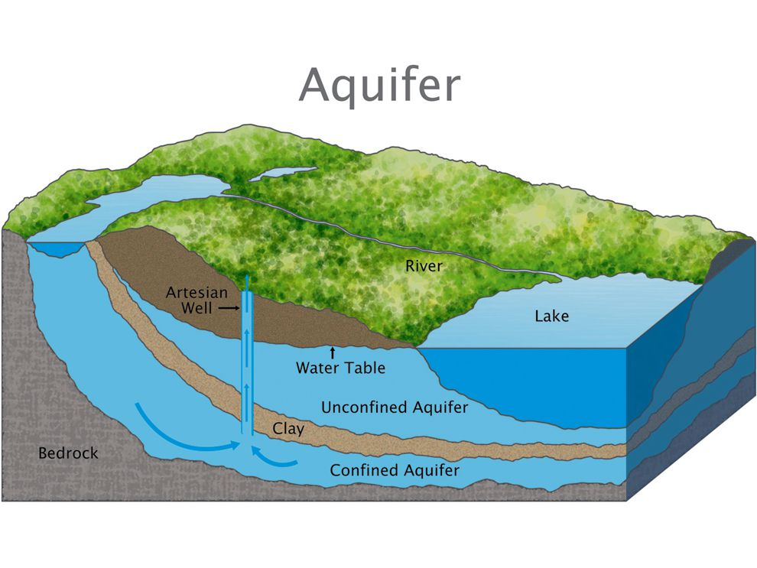
Ground water
Groundwater management deals with the complex interaction between human societal activities and the physical environment, which pose an extremely complex and difficult problem to solve for the benefit of all parties involved.
Unfortunately, humans are depleting the aquifers faster than they can be recharged by the hydrological cycle. Therefore, three quarters of groundwater is considered nonrenewable. The main reason we using groundwater resources mainly for drinking and irrigation.
Groundwater protection must be a high priority in zones where contamination can easily enter the aquifer and affect a spring or pumping well used for the drinking water supply of a large population.

Slide 5
Ground water-(cont)
If current trends continue, in 20 years about 60% of all India’s aquifers will be in a critical condition.India is the largest user of groundwater in the world. It uses an estimated 230 cubic kilometers of groundwater per year - over a quarter of the global total.More than 60% of irrigated agriculture and 85% of drinking water supplies are dependent on groundwater.

Slide 6
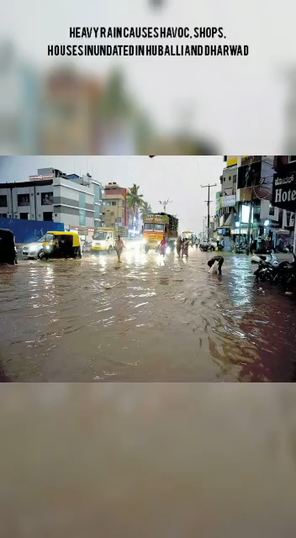

Slide 7
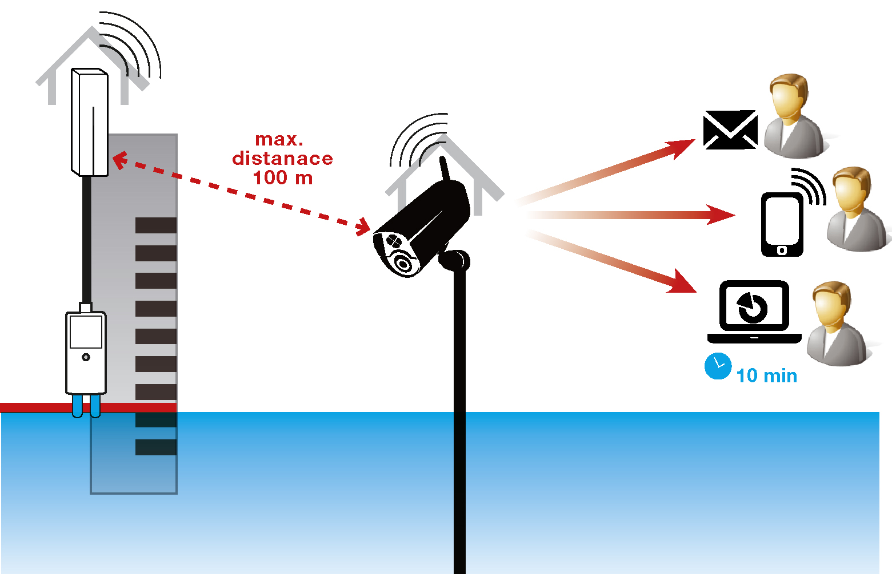
Flood water
Floods are important sources of groundwater recharge in most of the world’s arid lands with appropriate management practices, floods can benefit the ecology of arid and semi-arid areas
Flood spreading (due to river overflows) is one of the methods used for flood management and water harvesting that increases the groundwater recharge .
Recharge is the portion of infiltration that reaches the water table after passing through the soil profile . In arid environments, stream beds of rapid infiltration of flood water, which then recharges the local aquifers

Slide 8
Rain Water Management
Hubli-Dharwad Region has heavy rains for about 5 months in a year beginning from june.
It rains about 864 mm in Dharwad.
Citizens of Hubli-Dharwad have seen the rain water wreck havoc on them and enters the shops and houses.
We wish to give a solution to this and manage the rain water, so it neither enter the houses and shops during rainy season, nor do we harm the natural aquifers (Ground water reservoirs) by digging a bore well during summer.
A sustainable solution towards the water management will lead to a smart city with sustainable resources, of which water is one.
Water is vital to all, plants, animals and humans. When we say humans we mean drinking, agriculture and the like.

Slide 9
Rain water management -contd
The current metro area population of Hubli-Dharwad in 2022 is 1,158,000, a 1.85% increase from 2021. The metro area population of Hubli-Dharwad in 2021 was 1,137,000, a 1.79% increase from 2020. The metro area population of Hubli-Dharwad in 2020 was 1,117,000, a 1.73% increase from 2019.Hubli-Dharwad is the second largest city, in terms of area and population, in Karnataka.

Slide 10
External factors
Overflow of the conserverd water in reservoir
Collaborate to other reservoir
Geographical factor
We take it as consideration according to ward wise and identify the low lying houses.
Imbalance of land elevation of the city

Slide 11
Internal factors- it infrastructures
The use of artificial intelligence (AI) has also been a helpful tool to monitor the sustainable use of groundwater resources. Using floods sensors and and water level sensors, Internet of Things can help match the available resources and the quantity of water withdrawn.
Some practical applications of AI include controlling water wastage, especially due to issues like leakages and pipe bursts. For example, AI can monitor potential leaks in storage tanks, which is especially valuable since many tanks are connected to systems like bore wells that extract groundwater, which is then stored in the tanks.
Furthermore, technology like machine learning and big data are able to monitor the quality of water in real time, therefore identifying water pollution before it affects human health.

Slide 12
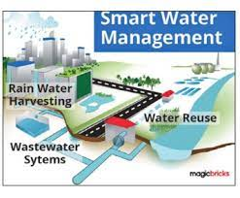
Internal factors affecting implementation
• Regulations, economic instruments and information to encourage behavioral changes.
to improve water quality, efficient water use, natural resource protection in Hubli-Dharwad
• National policy plans to improve/resolve water challenges.
• Commitments from internal funding bodies to meet and address the Sustainable Development Goals, including water which initiated by NIUA in Hubli-Dharwad.
• Commitment from leading organizations and stakeholders to address these environmental challenges, technical factors
• Allowing adequate time to design, develop, test and adjust technology for greater/more accurate results
• Undertaking a baseline assessment of the challenges and what needs to be addressed to ensure that the right mix of technology and non-technological solutions are implemented.
• Collaborating with all sectors to ensure adequate and accurate data (e.g. electricity data) are shared to support decision-making

Slide 13
Economic benefits
• Increased efficiency in irrigation systems and wastewater treatment systems
• Reduced waste by the reduction of water loss through leakages
• Job and opportunity growth through job creation through SWM project research,
design, development and implementation
• Improved capacity in water systems improving their capacity to manage flows and
reduce damage during storms/floods
• Reduction in future infrastructure costs by integrating smart technology tools to improve capacity/efficiency, resulting in less need for additional infrastructure
• Mobilization of funds from public sources, as well as internal funding sources

Slide 14
Smart city for developing country
Developing smart cities, either in the developed or in the developing counties, will help in convergence and interaction between urban agents and will result in sustainability and improvement of citizens’ life quality through a long-term plan.
For this study, poverty, education, infrastructure, healthcare facilities, an integrated governmental system, enabling and promoting public participation, preventing environmental degradation and eventually improving life quality are among the most important and key factors; thus, it tries to offer propositions to improve and solve the problems through information technology in the framework of Smart city projects

Slide 15
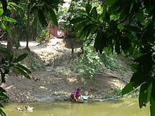
Smart city for developing country-cont
India is the largest user of groundwater in the world. It uses an estimated 230 cubic kilometers of groundwater per year - over a quarter of the global total.
Urban residents increasingly rely on groundwater due to unreliable and inadequate municipal water supplies.
Water issues in developing countries include scarcity of drinking water, poor infrastructure for water and sanitation access, water pollution, and low levels of water security. Over one billion people in developing countries have inadequate access to clean water. The main barriers to addressing water problems in developing nations include poverty, costs of infrastructure, and poor governance. The effects of climate change on the water cycle can make these problems worse.

Slide 16
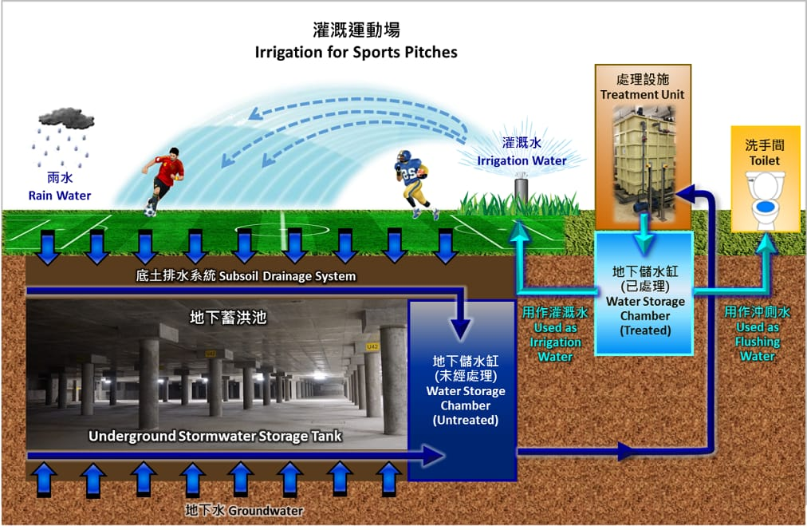
How do we accomplish?
Rain water , water from floods and other water bodies on earth’s surface pass through the soil by the process infiltration.
The infiltered water then gets accumulated in the aquifer deep under the ground.
There are some layers of impermeable rocks which prevent the water in the aquifer from seeping down further.

Slide 17
Energy sustainability for smart city
The reservoir can be covered with the solar panels to generate energy to pull the water (towards the reservior) and to purify the water.
Battery operated sensors can be employed.
Water flow can be used to turn turbines to produce hydro electricity.

Slide 18
Financial investment for implementation
Tangible asset infrastructure Investment -100cr.
IT infrastructure development- 5cr.
Annual preventive maintenance- 5cr.
Income expected- 8 to 9 cr.

Slide 19
Financial strategy
We may increase the water tax by a fractional value to use it for implementation of the project.
With the help net metering online water bill and the same is going to be incentivized based on the ground water contribution
If a house already has rain harvesting process, such households may be given subsidy for contribution of increase in water tax.
We save in the maintenance of the roads and sewage systems.
The corporation can sell the purified water from the plant.

Slide 20
Thank you

